Slide 1

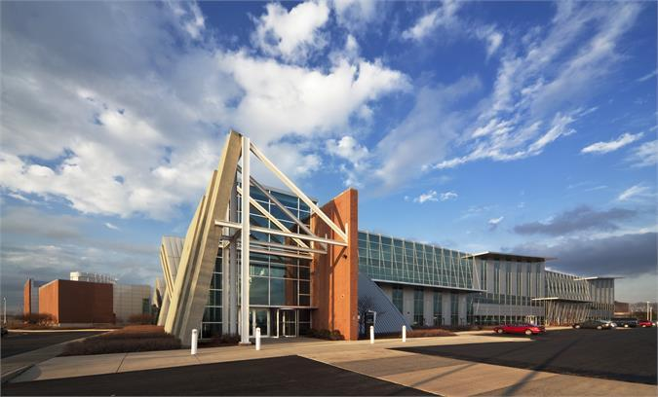
Agile Developer Training
Effective Software Delivery - Partnerships
July, 2015

Slide 2

Why?
  Quick response to change
  Improve customer satisfaction
  Gain competitive edge
What?
  Reduce time to market
  Improve software quality
  Foster a culture of craftsmanship
How?
  Continuous delivery / DevOps
  Robust development practices
  Culture of craftsmanship
  Sustainability
Notes:
Image © https://www.flickr.com/photos/hotcactuspepper/174848662

Slide 3
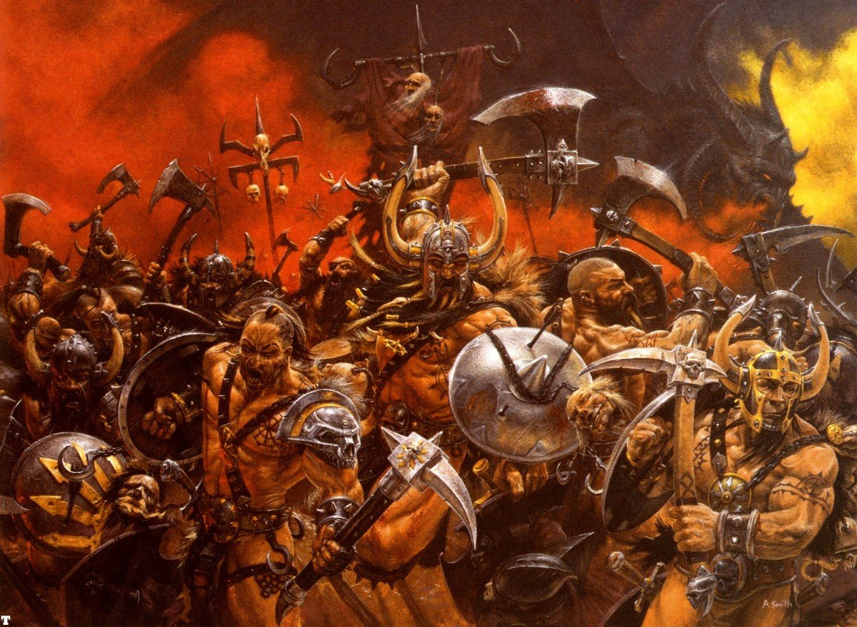
Self-Organization

Slide 4
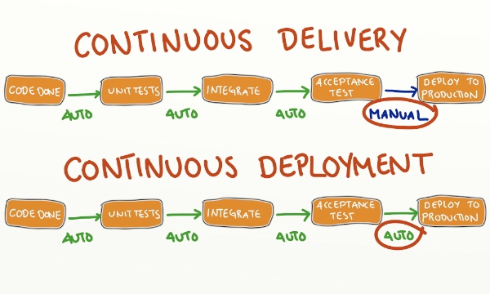
Continuous Delivery & Deployment

Slide 5

Cultivate in yourself a beginner’s mind
“In the beginner’s mind there are many possibilities,
in the expert’s mind there are few.”
Shunryu Suzuki
Notes:
Photo by Esti Alvarez, Creative Commons Attribution Non Commercial ShareAlike 2.0

Slide 6
from to
Why we can’t How can we...
Component teams ...create feature teams?
After-the-fact testing ...build in quality?
and hardening take time
Governance, legal, UX, ...build in compliance?
marketing, security
reviews take time
Many cross-team and ...realign ARTs with product
cross-ART dependencies lines & value streams?
Too many meetings ...communicate efficiently?
The organization just is ...change the organization
what it is. “They” won’t
let us change anything.

Slide 7
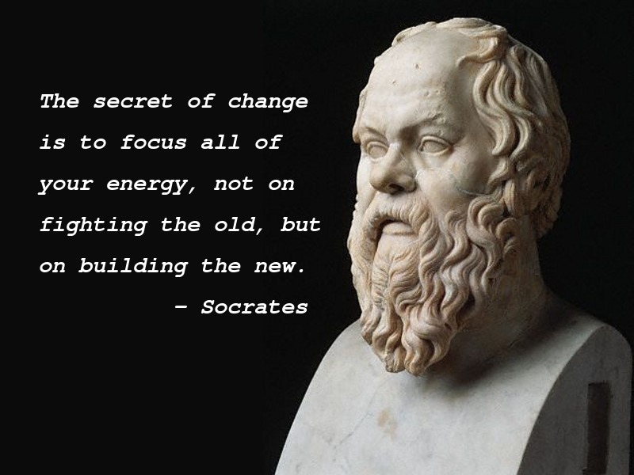

Slide 8
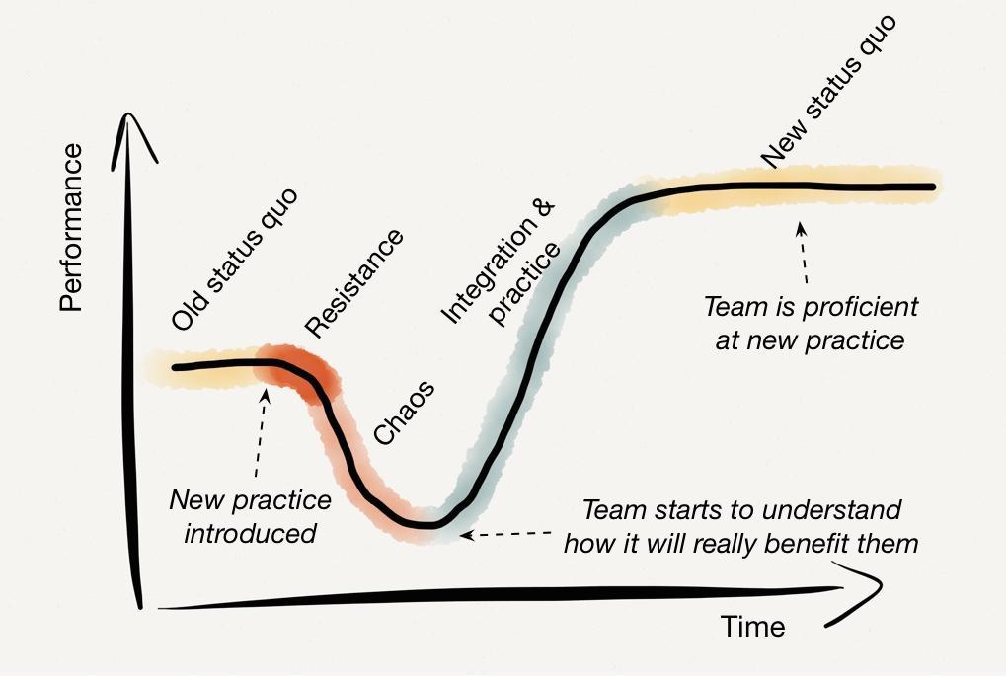
Satir Change Curve
Notes:
Diagram from Growing Agile Technical Excellence, © Mike Bowler, used with permission

Slide 9
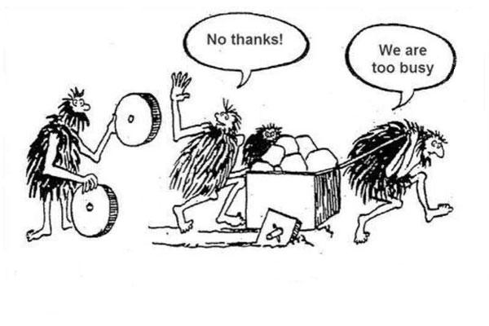
Are you too busy to improve?

Slide 10

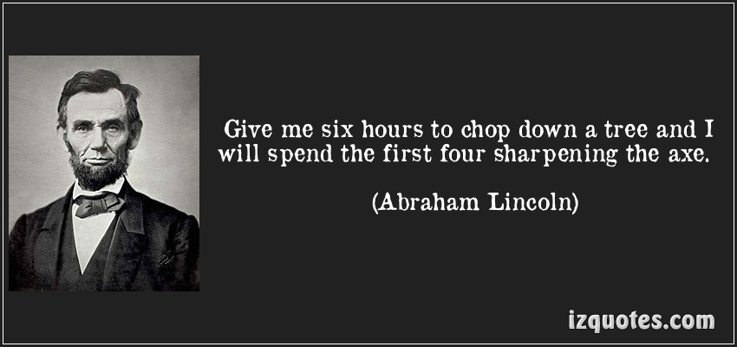

Slide 11
Models Help Us Think About Things
All models are wrong, but some models are useful.
- George Box

Slide 12
Agile
http://agilemanifesto.org
http://www.halfarsedagilemanifesto.org/

Slide 13
Systems Thinking
https://www.youtube.com/watch?v=uaGEjrADGPA

Slide 14
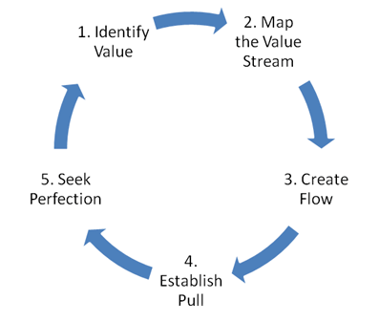
Lean

Slide 15
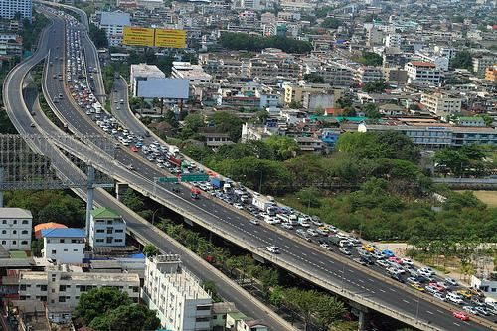
Utilization vs. Throughput

Slide 16
Time Lost to Waiting
Hand-offs between roles
Cross-team dependencies
Waiting
Interruptions & context-switching
After-the-fact testing
Review, approval, & governance processes

Slide 17
Time Lost to Re-Work
Fixing regressions
Fixing escaped defects
Re-work
Misunderstood
requirements
Remediating technical debt
Test cases that don’t align with requirements

Slide 18
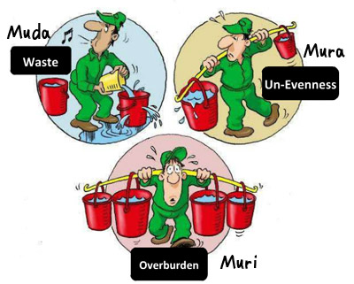
Muda – Mura – Muri

Slide 19
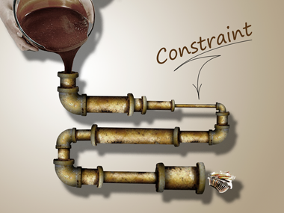
Theory of Constraints

Slide 20
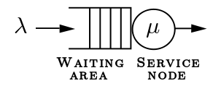
M/M/1 Queue

Slide 21
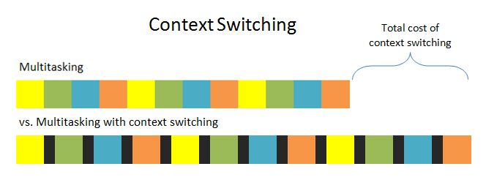
Context Switching Overhead
This can be between 10 and 30 minutes
Illustration from
http://www.bryanbraun.com/2012/06/25/multitasking-and-context-switching

Slide 22
Manager's Schedule, Maker's Schedule
“For someone on the maker's schedule, having a meeting is like throwing an exception. It doesn't merely cause you to switch from one task to another; it changes the mode in which you work.”
- Paul Graham

Slide 23
Some Other Stuff...
Last Responsible Moment
Limiting Work-in-Process

Slide 24



Borat Prioritization
Not!
Everything is a “must have!”
Did you hear something?
Nope
Product Owner
Development Team

Slide 25
Prioritization
The business priorities are: #1, #2, #3
Let’s do it!
Got it!
Product Owner
Development Team

Slide 26
Scrum - Planned Work
Here’s the prioritized sprint backlog
No problem, we can do that
Product Owner
Development Team

Slide 27

Borat Scrum - Stretch Goals
Not!
Hey, maybe you can stretch a little!
A 12-oz glass holds 12-oz.
It doesn’t stretch. Neither do we.
Product Owner
Development Team

Slide 28
Scrum - Unplanned Work
An urgent item came up unexpectedly!
No problem. Which stories would you like to drop from the sprint?
Product Owner
Development Team

Slide 29
Scrum - Unplanned Work
Let’s drop 4 and 5 and slot it in at #4
Will do.
Product Owner
Development Team

Slide 30
Kanban - Planned Work
Standard Work (2)
Here’s the prioritized work queue
To do Doing
No problem, we can do that
Expedite (1)
To do Doing
Product Owner
Development Team

Slide 31
Kanban - Unplanned Work
Standard Work (2)
An urgent item came up unexpectedly!
To do Doing
No problem, we can do that
Expedite (1)
To do Doing
Product Owner
Development Team

Slide 32
Transparency
https://www.youtube.com/watch?v=NkQ58I53mjk

Slide 33
Scrum Guide
http://scrumguides.org/scrum-guide.html

Slide 34
Bad Sprint Review
https://www.youtube.com/watch?v=Q6jMgmPIxmk

Slide 35
SAFe Overview
http://scaledagileframework.com/

Slide 36
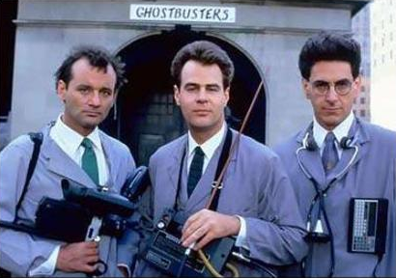
Cross-Team & Cross-ART Dependencies

Slide 37
Team Structure & Logistics
Collaborative work spaces
Distributed teams
Dispersed teams
Feature teams
Component teams
Cross functional teams
Dedicated teams
Stable teams
Full-stack developer

Slide 38

Communication

Slide 39
Active Listening
https://www.youtube.com/watch?v=aP55nA8fQ9I
https://www.youtube.com/watch?v=4VOubVB4CTU

Slide 40
Powerful Questions
Huh?

Slide 41

Revisit Pair Programming
Pairing
Notes:
More
Image © Menlo Inovations

Slide 42
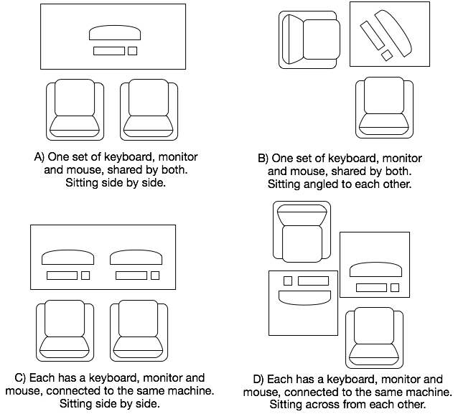
Notes:
Diagram from Growing Agile Technical Excellence, © Mike Bowler, used with permission

Slide 43
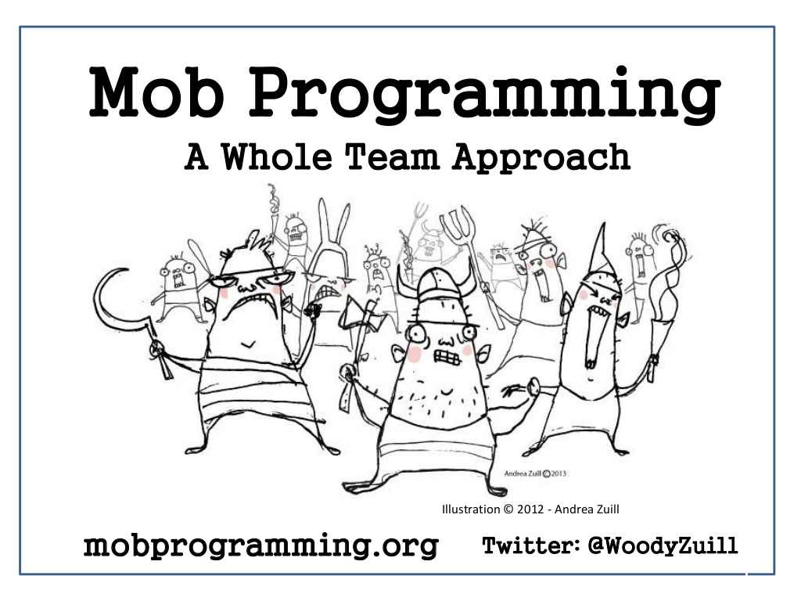
Notes:
Show the mob programming time-lapse video.

Slide 44
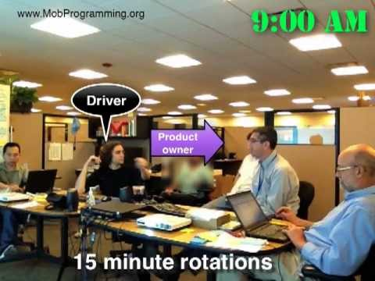

Slide 45
What's in a User Story?
What is needed? (General)
Who needs it?
What’s the value to them?
How can we tell when it’s done?
Pointers to more-detailed documentation (if needed)

Slide 46
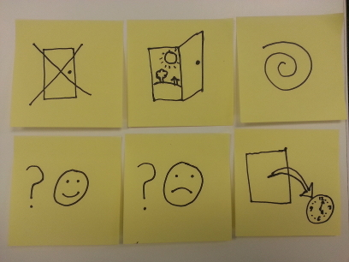
Placeholder for a Conversation

Slide 47
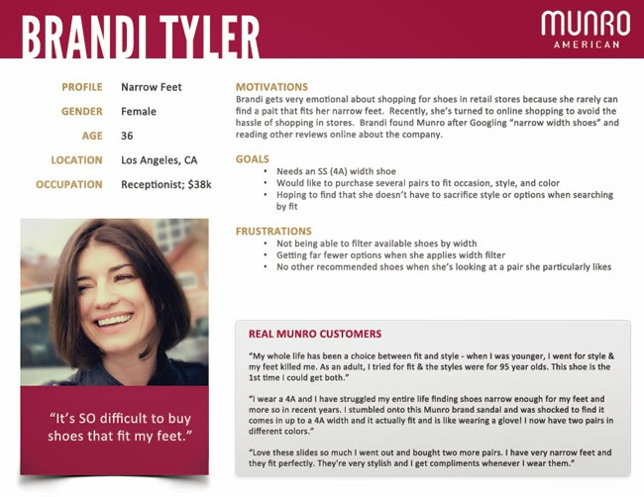
Personas

Slide 48
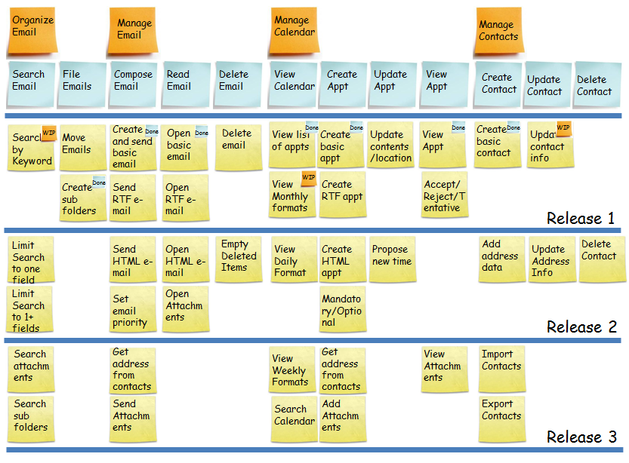
Story / Feature Mapping

Slide 49

General Work Flow
PI Planning
Backlog
BDD / ATDD
Sprint
Planning
Sprint
Backlog
TDD
Sprint
Work

Slide 50
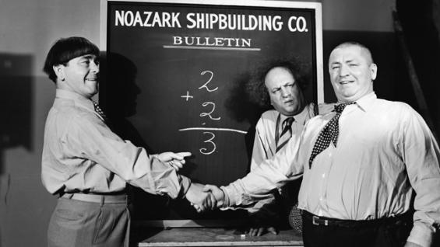
The Three Amigos
Ensure common & accurate understanding

Slide 51
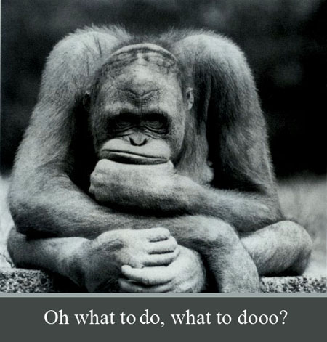
Definition of Ready & Done
Team needs to know when to stop.
If it isn’t clear, then don’t start.

Slide 52
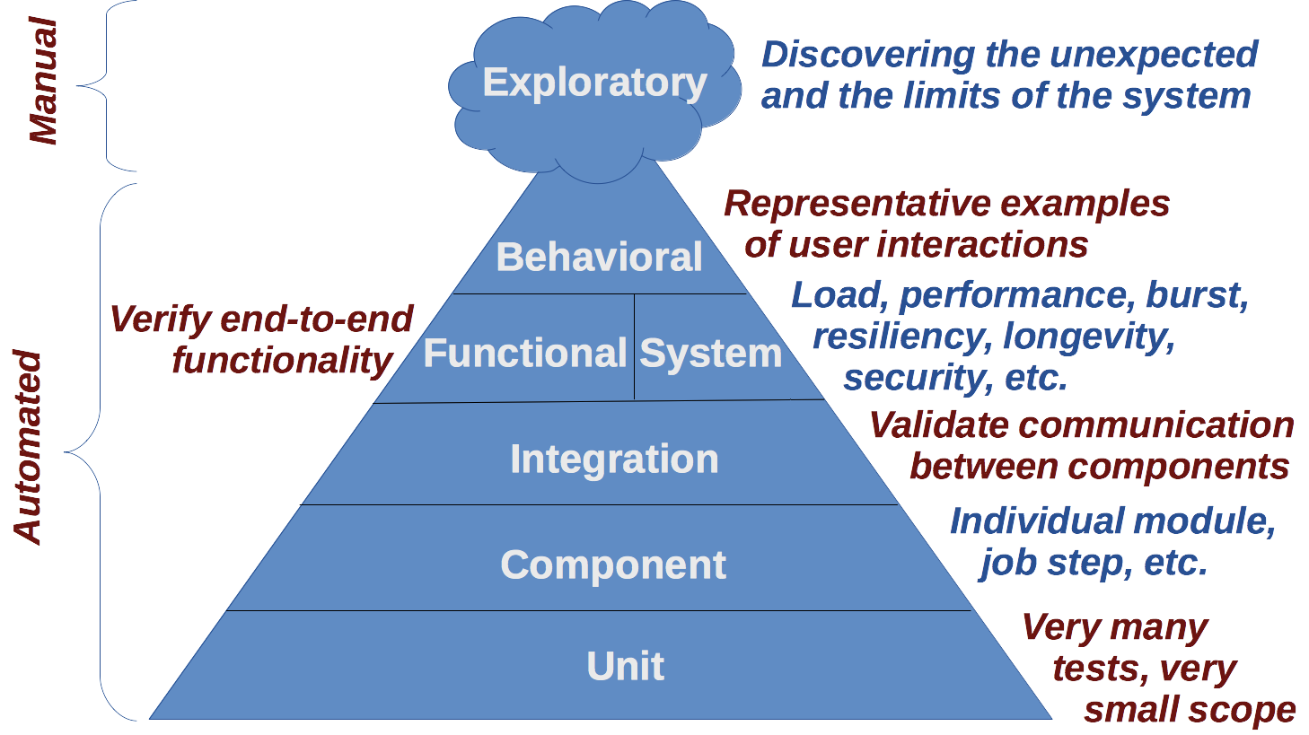
Testing Pyramid (General)

Slide 53
Summary: How To Get Things Done
Know your capacity
Set your utilization at 70% (not 100%)
Understand business priorities
Understand relative value
Do the most valuable things first
Do one thing (or very few) at a time
Don’t start until you know what “done” looks like
When blocked, remove the block
(don’t start something new)
Keep people with rare skills available to help others
Learn from all outcomes
Apply good technical practices rigorously

Slide 54
Testing/Checking Pyramid
Cucumber

Slide 55
Structure of a Test Case
Set up preconditions
Exercise the code under test
Check the results

Slide 56
Gherkin or GWT: A Language for Tests
Given: Set up preconditions
When: Exercise the code under test
Then: Check the results

Slide 57
Domain Specific Language
A language specialized for a given “domain”
Example Domain
GML (GameMaker) Learning to program
XML Structuring data
Math notation Mathematics
JUnit Unit testing (Java)
R Data analysis
J Array processing
Gherkin Requirements elaboration

Slide 58
Gherkin Language
Feature
Scenario
Scenario Outline
Given
When
Then
And
Not recommended
But

Slide 59
Gherkin Example
Feature: Customer login
Scenario: Successful login
Given John Smith is a registered customer
When he logs in as “smith12” with password “goodpass”
Then the landing page is displayed
And the welcome message reads “Welcome back, John!”
Scenario: Wrong password
Given John Smith is a registered customer
When he logs in as “smith12” with password “funky”
Then the login form is displayed
And the error message reads
“Unknown username or password”

Slide 60
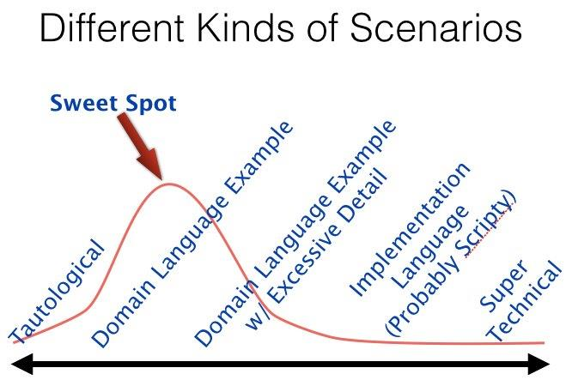
Use Plain Domain Language

Slide 61
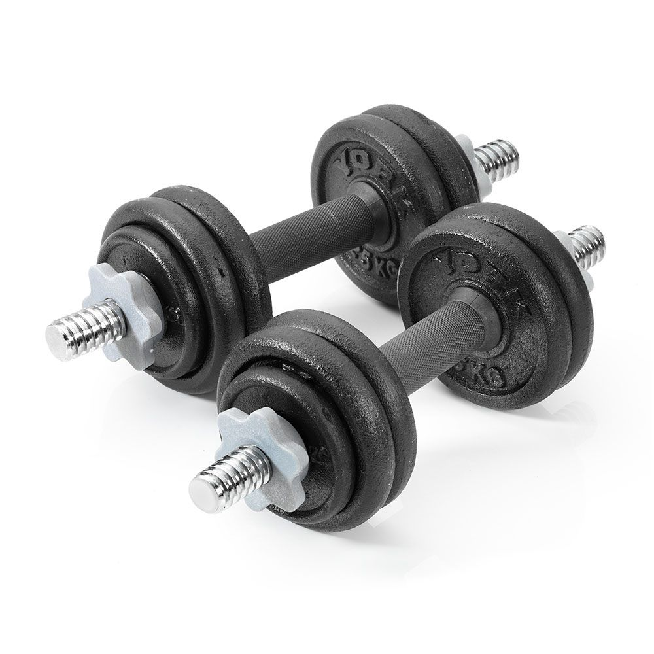
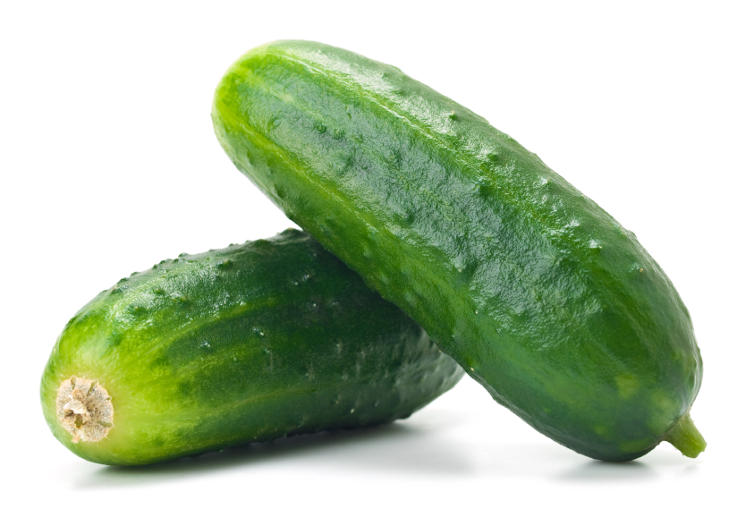
Gherkin Exercise

Slide 62
Gherkin, Cucumber, and ATDD Workflow
PSI Planning
About 1 to 1.5 sprints of Stories meet the Definition of Ready
Sprint Planning
Prepare Stories for the next sprint.
VersionOne
Acceptance Criteria include initial Gherkin scenarios.
Version Control
Merge Gherkin from VersionOne with existing Gherkin from version control.
Add scenarios to flesh out the Stories.

Slide 63
Gherkin, Cucumber, and ATDD Workflow
Sprint
Pull next Story in priority order.
Three Amigos.
Ruby
Write steps for the Cucumber scenarios.
Application Language
Write code to make the scenarios pass.

Slide 64
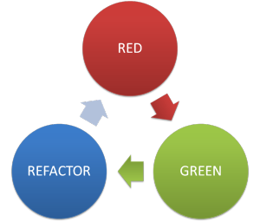
Test-Driven Development (TDD)

